Slide 1
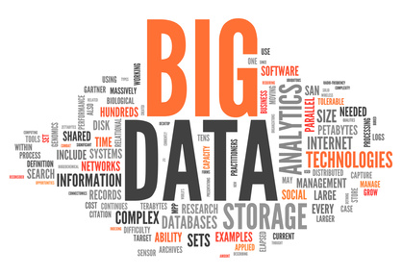
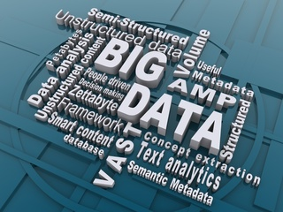

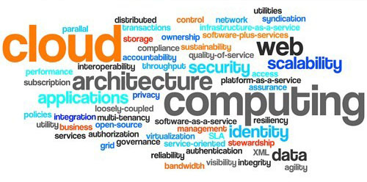

Cloud based solutions for Big Data: Cloud based Big Data Infrastructure and Platforms, SQL and NoSQL databases,
DevOps and DataOps
Yuri Demchenko
System and Networking Lab, UvA
CN
CN
CN
CN
CN
CN
CN
CN
CN
CN
CN

Slide 2
Outline
Definitions
Big Data, Cloud Computing, Data Science
Standardisation
NIST, CSA, DMTF, IDS, RDA, DAMA. IEEE
Big Data platforms and tools
Big Data Storage, SQL and NoSQL, modern databases
Apache Hadoop Ecosystem
AWS, Google Cloud Platform, Azure
DevOps and DataOps
Cloud automation and monitoring tools
Azure DevOps services and tools
Data Markets and Data Exchange
Data properties as economic goods
Essential Big Data and Data Science Competences and Skills
EDISON Data Science Framework (EDSF)
Learning and development resources
How to become a Data Scientist
Discussion
This work is licensed under the Creative Commons Attribution 4.0 International License. To view a copy of this license, visit http://creativecommons.org/licenses/by/4.0/

Slide 3
Yuri Demchenko, Senior Researcher, Lecturer, UvA
Graduated and PhD from National Technical University of Ukraine “Kiev Polytechnic Institute”
University of Amsterdam – since 2003
Research areas
Big Data Infrastructure and Data Science platforms
Cloud architecture, cloud automation and DevOps
Cloud security and compliance
Teaching courses (on campus and online)
Big Data Infrastructure and Technologies
Cloud powered Software Engineering and DevOps
Data Science Foundations, Professional Issues in Data Science
Security Engineering
Recent projects
EDISON: Building the Data Science Profession for Europe
MATES: Digitalisation of the European Blue Economy
CYCLONE: Multi-cloud automation platform for cloud based applications
GEANT4 Research: Cloud aware networking infrastructure provisioning on-demand

Slide 4
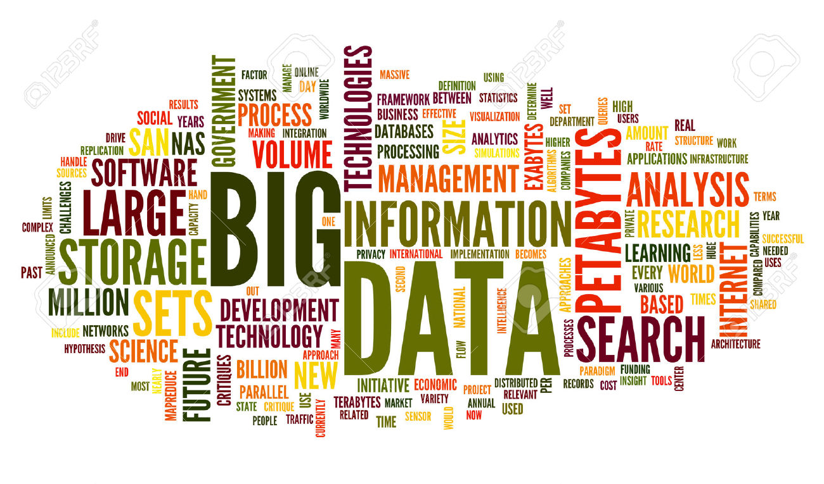
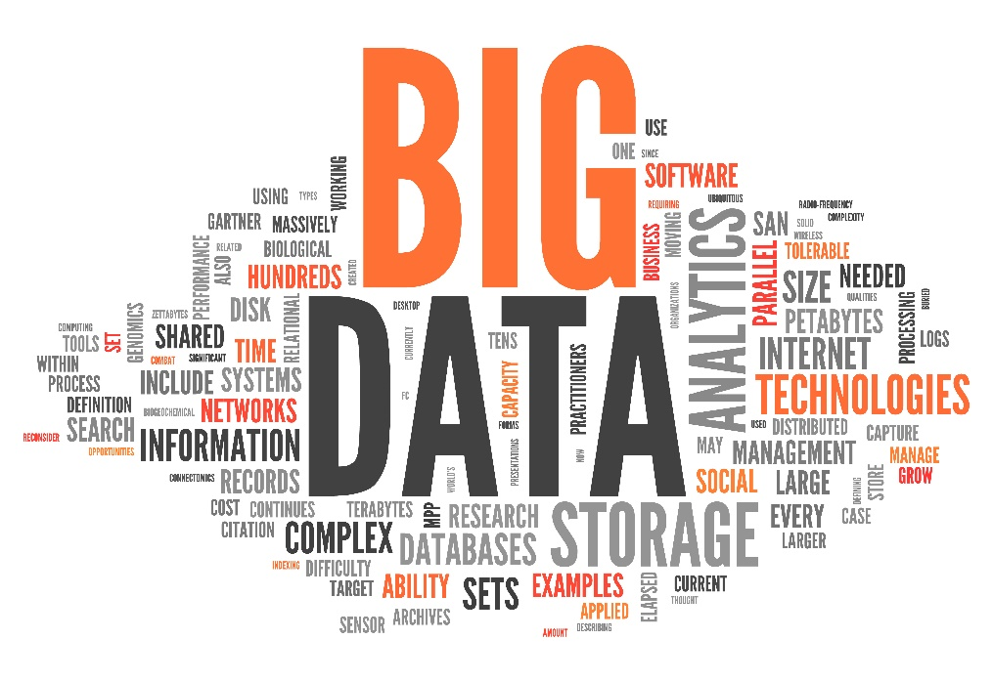
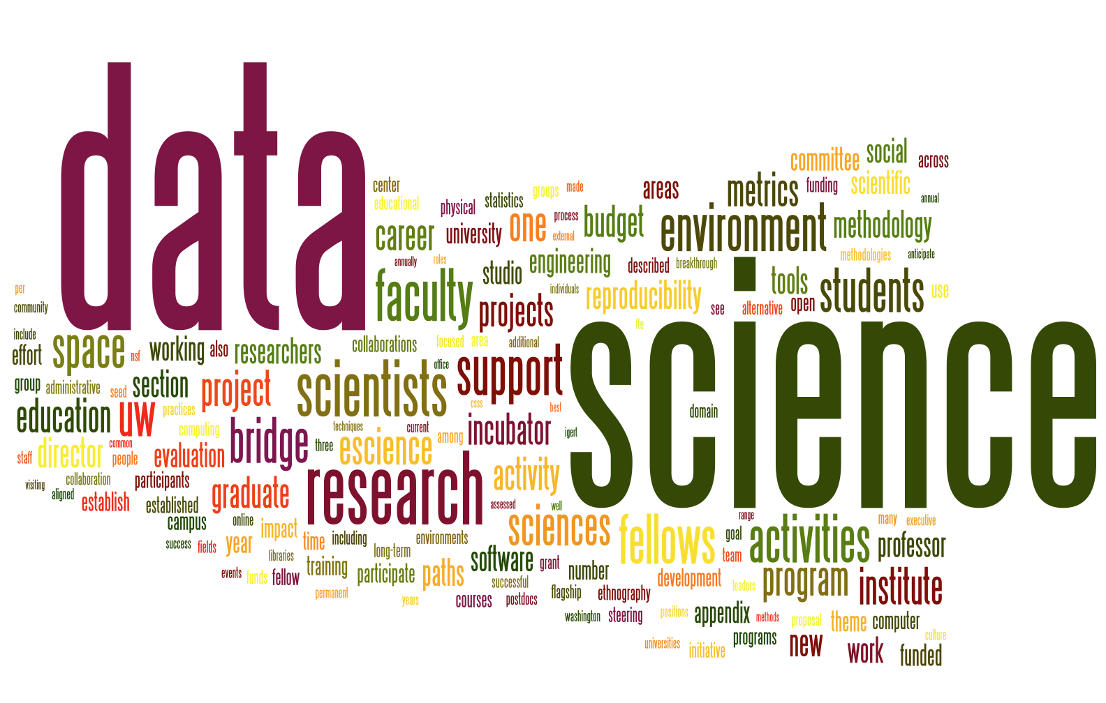
Multiple aspects of Big Data
Big Data is a complex of technologies to enable handling of Big Data (storage, processing, transfer, security)

Slide 5
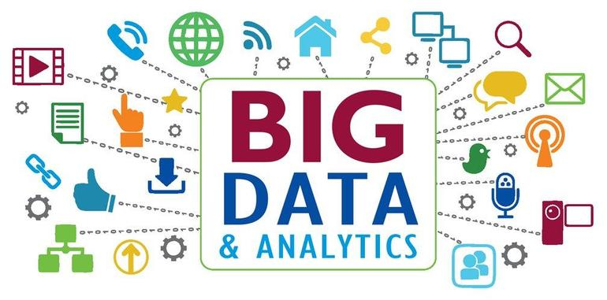
Big Data and multiple sources of data
Social Media
IoT
Internet
Science
Industrial data
Communication, voice
Data analytics blending with open and social media data

Slide 6
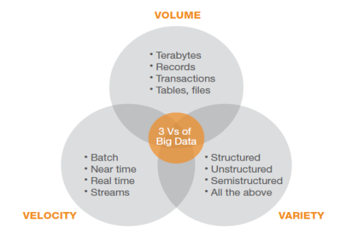
Big Data Properties: 6 (3+3) V’s of Big Data
Volume
Generic Big Data Properties
Volume
Variety
Velocity
Acquired Properties (after entering system)
Value
Veracity
Variabilityfc AD
Terabytes
Records/Arch
Tables, Files
Distributed
Variety
Velocity
Structured
Unstructured
Multi-factor
Probabilistic
Linked
Dynamic
Batch
Real/near-time
Processes
Streams
6 Vs of
Big Data
Changing data
Changing model
Linkage
Value
Correlations
Statistical
Events
Hypothetical
Variability
Trustworthiness
Authenticity
Origin, Reputation
Availability
Accountability
Adopted in general
by NIST Big Data Working
Group (NBD-WG) [ref]
Commonly accepted
3V’s of Big Data
by Gartner [ref]
Veracity
Notes:
It is widely used metaphor to represent Big Data properties as 3V or 5V properties.
We will brig to the Big Data definition more structure approach.
We can admit that the famous 3V of Big Data are generic Big Data properties:
Volume
Variety
Velocity
However the Big Data after entering the system will acquire a number of new properties of which another 3V are commponly accepted
Value
Veracity
Variability
The similar model is proposed in the NIST Big Data standards group published by the NIST Big Data Working
Group (NBD-WG)

Slide 7
Big Data Definition: More than just BD properties
(1) Big Data Properties: 6V
Generic: Volume, Variety, Velocity
Ecquired: Value, Veracity, Variability
(2) New Data Models
NoSQL
Data linking, provenance and referral integrity
Data Lifecycle and Variability/Evolution
(3) New Analytics
Real-time/streaming analytics, interactive and machine learning analytics
(4) New Infrastructure and Tools
High performance Computing, Storage, Network
New Data Centric (multi-stakeholder) service models
New Data Centric security models for trusted infrastructure and data processing
(5) Source and Target
High velocity/speed data capture from variety of sensors and data sources
Data delivery to different visualisation and actionable systems and consumers
Fully digitised input and output, (ubiquitous) sensor networks, full digital control
Notes:
To make better link to the current practice and trends in Big Data technologies and platforms definition we will use/propose the more structured Big Data definition that includes the 5 parts addressing different aspects of the Big Data technology domain.
(1) Big Data Properties: 5V
(2) New Data Models
(3) New Analytics
(4) New Infrastructure and Tools
(5) Source and Target
Importance of including Data Source and Target is explained by the specific of Big Data technologies where technical solutions strongly depend on the data types, data properties collected and the form and method how the data need to delivered to consumer or target system.

Slide 8
Cloud Computing, Big Data, Data Science
Cloud Computing
Infrastructure/Platform/Software as a Service (IaaS/PaaS/SaaS)
Private, public, hybrid, community, federated
Big Data
Technology domain to enable handling of Big Data (storage, processing, transfer, security)
Big Data properties and new data centric models
Data Science (NIST)
Data science is the extraction of actionable knowledge directly from data through a process of discovery, or hypothesis formulation and hypothesis testing.
Data science combines concepts and methods from multiple disciplines to enable whole data lifecycle to bring value to business

Slide 9
Technology Maturity and Standardisation
NIST: Cloud Computing (2008-2013) and Big Data (2013-now)
Cloud Computing Reference Architecture (CCRA)
Big Data Reference Architecture (BDRA)
DMTF – Distributed Management Task Force
Cloud Information Model (CIM)
Open Virtualisation Format (OVF)
CSA – Cloud Security Alliance
Cloud Compliance and Big Data Security Controls
RDA – Research Data Alliance
PID, Data Factories, Data Registries
DAMA – Data Management Association
Data Management Body of Knowledge (DMBOK)
Industrial Data Space Association (IDS)
Industrial Data Space Architecture

Slide 10
NIST Big Data Working Group (NBD-WG) and ISO/IEC JTC1 Study Group on Big Data (SGBD)
NIST Big Data Working Group (NBD-WG) is leading the development of the Big Data Technology Roadmap - http://bigdatawg.nist.gov/home.php
Built on experience of developing the Cloud Computing standards fully accepted by industry
Set of documents delivered September 2014 (to be published as NIST Special Publication documents) - http://bigdatawg.nist.gov/V1_output_docs.php
Volume 1: NIST Big Data Definitions
Volume 2: NIST Big Data Taxonomies
Volume 3: NIST Big Data Use Case & Requirements
Volume 4: NIST Big Data Security and Privacy Requirements
Volume 5: NIST Big Data Architectures White Paper Survey
Volume 6: NIST Big Data Reference Architecture
Volume 7: NIST Big Data Technology Roadmap
NBD-WG defined 3 main components of the new technology:
Big Data Paradigm
Big Data Science and Data Scientist as a new profession
Big Data Architecture
The Big Data Paradigm consists of the distribution of data systems across horizontally-coupled independent resources to achieve the scalability needed for the efficient processing of extensive datasets.
Notes:
NIST BD-WG is leading the development of a Big Data Technology Roadmap.
This roadmap will define and prioritize requirements for interoperability, portability, reusability, and extendibility for big data analytic techniques and technology infrastructure in order to support secure and effective adoption of Big Data.
Wide involvement from industry, academia, research and government

Slide 11
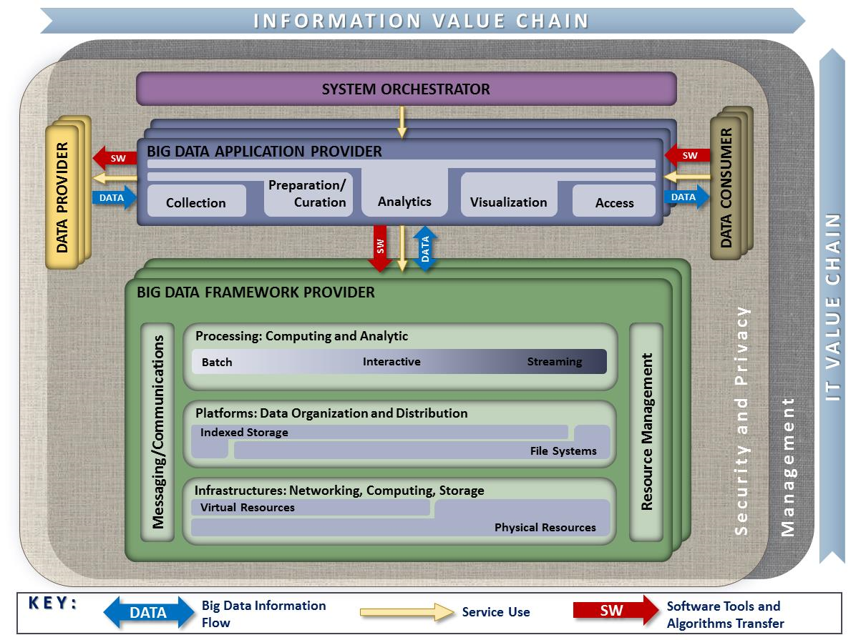
NIST Big Data Reference Architecture (2018)
Main components of the Big Data ecosystem
Data Provider
Big Data Applications Provider
Big Data Framework Provider
Data Consumer
Service Orchestrator
Big Data Lifecycle and Applications Provider activities
Collection
Preparation
Analysis and Analytics
Visualization
Access
Big Data Ecosystem includes all components that are involved into Big Data production, processing, delivery, and consuming
[ref] Volume 6: NIST Big Data Reference Architecture. http://bigdatawg.nist.gov/V1_output_docs.php
Notes:
Important to mention that NIST BD-WG recognizes the environment in which the Big Data are collected, processed and consumed as Ecosystem.
Data Provider is the role of introducing new data or information feeds into the big data system for discovery, access, and transformation by the big data system.
Big Data Application Provider is the role of executing a specific set of data life cycle to meet the requirements established by the System Orchestrator, as well as the Security and Privacy requirements.
Big Data Application Provider includes activities related to the Big Data Lifecycle
Collection
Preparation
Analysis and Analytics
Visualization
Access
As the data propagates through the ecosystem, it is being processed and transformed in different ways in order to extract the value from the information. Each activity within the Big Data Application Provider can be implemented by independent stakeholders and deployed as stand-alone services. As such, the "Application Provider" can be a single or a collection of more granulate "Application Providers", each implementing different steps in the "data lifecycle".
Data Provider activities include:
Collecting the data
Creating the metadata describing the data source(s), usage policies/access rights, and other relevant attributes
Publishing the availability of the information and the means to access it

Slide 12
Data Lifecycle/Transformation Model
Multiple Data Models and structures
Data Variety and Variability
Semantic Interoperability
Data Model (1)
Data Model (1)
Data Model (3)
Data (inter)linking
PID/OID
Identification
Privacy, Opacity
Data Model (4)
Data Storage (Big Data capable)
Data
Collection& Registration
Data
Analytics, Modeling,
Prediction
Consumer applications
Data
Filter/Enrich,
Classification
Data
Delivery,
Visualisation
Data
Source
Data repurposing,
Analytics re-factoring,
Secondary processing
Data Model changes along data lifecycle or evolution
Data provenance is a discipline to track all data transformations along lifecycle
Identifying and linking data
Persistent data/object identifiers (PID/OID)
Traceability vs Opacity
Referral integrity
Notes:
Data Lifecycle/Transformation Model is an important component of the BDAF that affect many aspects of the Big Data infrastructure.
-
It imposes a number of requirements for data management infrastructure that should provide functions for
Data must stored during all transformation stages providing linking and traceability to initial data sets
Data provenance that should allow tracking and recording/documenting all data transformation during lifecycle, ensuring referral integrity of data
Data curation that includes activities to ensure long-term data preservation and availability, may also include data indexing, classification and metadata creation
It is perceived that Data Model may change during data transformation. Data storage solutions should allow data model/structure variability.
NoSQL databases actually have been created to address this kind of problem. Specifically, key/value and columnar NoSQL databases and their numerous implementations allow changing data models and schema.
Important feature of Big Data Life is possibility of Data repurposing and secondary processing applying improved analytics methods. Having also a possibility to run historical data analysis.

Slide 13
SQL and NoSQL
NoSQL definition (www.nosql-database.org):
Next Generation Databases mostly addressing some of the points: being non-relational, distributed, open-source and horizontal scalable.
Other characteristics apply: schema-free, easy replication support, simple API, eventually consistent / BASE (not ACID), a huge data amount, others
ACID/SQL vs BASE/NoSQL
ACID Semantics: Atomic, Consistent, Isolated, Durable
BASE Semantics: Basically Available - Soft State - Eventual Consistency

Slide 14
NoSQL Distinguishing Characteristics
Large data volumes
Web scale “Big Data”
Scalable replication and distribution
Potentially thousands of machines
Potentially distributed around the world
Queries need to return answers quickly
Not necessary precisely
Employing probabilistic search/decision
Mostly query, few updates
Asynchronous Inserts and Updates
Schema - free
Paradigm shift from ACID transaction properties to BASE
CAP Theorem – NoSQL database types
Open source development

Slide 15
Brewer’s CAP Theorem
Brewer’s (CAP) Theorem (original formulation) [ref]
“There are three core systemic requirements that exist in a special relationship when it comes to designing and deploying applications in a distributed environment.”
A distributed system can support only two of the following characteristics:
Consistency
All nodes see the same data at the same time
Availability
Node failures do not prevent survivors from continuing to operate
Partition tolerance
The system continues to operate despite arbitrary message loss
[ref] http://www.julianbrowne.com/article/viewer/brewers-cap-theorem
Consistency
CA
Availability
Not Possible
CP
AP
Partition Tolerance
The CAP Theorem Dilemma in Cloud Database and Storage

Slide 16
Main NoSQL Database Types and Existing Implementations
Column Store: Each storage block contains data from only one column
BigTable by Google, Apache HBase, Cassandra
Work natively with HDFS and Hadoop
Document Store: Store documents (in particular XML) made up of tagged elements
MongoDB, CouchDB, RaptorDB, CosmosDB
Key-Value Store: Hash table of keys with arbitrary data as content/value
Memcached, Membase, Accumulo, Amazon DynamoDB
Graph Databases: Store data in graph data in Triplestores or Quadstores
Neo4J, FlockDB, GraphDB
Notes:
Should we refer students to a specific tutorial?

Slide 17
Visualizing the CAP Theorem and it’s members
Data Models:
(R) Relational (Comparison)
(K) Key Value
(C) Column-Oriented/Tabular
(D) Document-Oriented
(G) Graph
Configurable consistency:
Azure CosmosDB (K,C,D,G), AWS Aurora (R), Google Spanner (R)
Availability
Each client can always read and write
CA
(R) RDBMs such | (R) Aster Data
as MySQL, Oracle, | (R) Greenplum
DB2, PostgreSQL, | (D) CouchDB
SQL Server, etc. | (C) Vertica
A
AP
(K) Dynamo | (C) Cassandra
(K) Voldemort | (D) SimpleDB
(K) Tokyo Cabinet | (D) CouchDB
(K) KAI | (D) Riak
Pick Two
C
P
Consistency
All clients always have the same view of data
Partition Tolerance
The system works well despite physical network partitions
 | CP
(C) BigTable | (D) MongoDB | (K) BerkeleyDB | (R) VoltDB
(C) Hypertable | (D) Terastore | (K) MemcacheDB
(C) Hbase | (K) Scalaris | (K) Redis
Notes:
The diagram on this slide illustrates the CAP Theorem visibly. It also categorizes commercial and open source implementations into one of the three CAP Theorem categories.

Slide 18
Modern Cloud Databases and CAP Theorem Challenges
Google Spanner SQL database
AWS Aurora Big SQL database
Azure CosmosDB (NoSQL multi-data format database with underlying blob storage and HDFS)

Slide 19
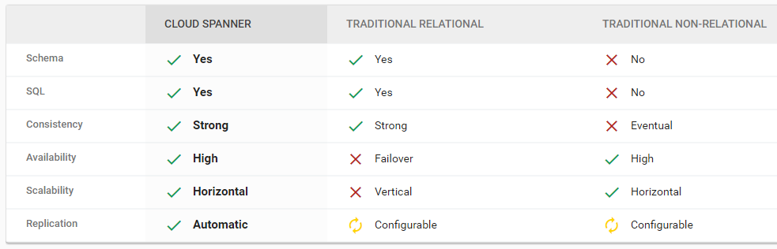
Cloud Spanner - Mission Critical RDBMS
SQL Database
Best of both worlds
Strong consistency and high availability worldwide

Slide 20
Amazon Aurora – Big SQL database
High performance and scalability
High availability and durability
High security
MySQL and PostgreSQL Compatible
Fully managed
Migration support

Slide 21
Azure CosmosDB (former DocumentDB) – Multi-model global distributed database

Slide 22
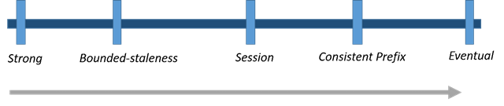
CosmosDB: Consistency and latency
Five Consistency Models
Helps navigate Brewer's CAP theorem
Intuitive Programming
Tunable well-defined consistency levels
Override on per-request basis
Clear PACELC tradeoffs
Partition – Availability vs Consistency
Else – Latency vs Consistency
Guaranteed low latency at P50 and P99 percentile
Globally distributed with requests served from local region
Write optimized, latch-free database
Automatic Indexing

Slide 23
CosmosDB: Consistency levels and guarantees
Consistency Level | Guarantees
Strong | Linearizability
Bounded Staleness | Consistent Prefix. Reads lag behind writes by k prefixes or t interval
Session | Consistent Prefix. Monotonic reads, monotonic writes, read-your-writes, write-follows-reads
Consistent Prefix | Updates returned are some prefix of all the updates, with no gaps
Eventual | Out of order reads
Lower latency, higher availability, better read scalability

Slide 24
Hadoop and Big Data processing Platforms

Slide 25
Apache Hadoop (Release 2.7+)
Pig
Other Hadoop-related projects at Apache include:
HBase: A distributed column oriented database that supports structured data storage for large tables
Hive: A data warehouse system that provides data aggregation and querying.
Pig: A high-level data-flow language and execution framework for parallel computation.
Mahout: A scalable machine learning and data mining library.
Tez: A generalized data-flow programming framework, built on Hadoop YARN, which provides a powerful and flexible engine to execute an arbitrary DAG of tasks to process data for both batch and interactive use-cases.
ZooKeeper: A scalable coordination service for distributed applications.
Spark: A fast and general compute engine for Hadoop data. Spark provides a simple and expressive programming model that supports a wide range of applications, including ETL, machine learning, stream processing, and graph computation.
Avro: A data serialization system that supports rich data structures
Solr: Data visualisation tools, dashboard design.
Hue: User GUI
Ambari: A web-based tool for provisioning, managing, and monitoring Apache Hadoop clusters
Flink, Storm, Flume, Sqoop, Oozie
Hive
Tez
Chukwa, Others
HBase
MapReduce
Zookeeper
Ambari
YARN + Tez
HDFS
Apache Hadoop software stack includes the following main modules:
Hadoop Common: The common utilities that support the other Hadoop modules and includes utilities and drivers to support different computer cluster and language platforms.
HDFS: Hadoop Distributed File System optimized for large scale storage and processing of data on commodity hardware
Hadoop YARN: A framework for job scheduling and cluster resource management.
Hadoop MapReduce: A YARN-based system for parallel processing of large data sets.
Notes:
Apache Hadoop is a core component of a modern data architecture that is currently integrated with existing enterprise data management and in particular Enterprise Data Warehouse
Apache Avro provides important functionality for consistent data management that includes rich data structures
JSON based container file for storing persistent data, and
Remote Procedure Call (RPC) for low overhead data communication.
JSON based schema for data structure description is stored together with data and easily integrated with the programming platform.

Slide 26


Hive and Pig Latin
Solution: Provide higher-level data processing languages
Hive: Data warehousing application in Hadoop
Query language is HQL, variant of SQL
Tables stored on HDFS as flat files
Developed by Facebook, now open source
Pig: Large-scale data processing system
Scripts are written in Pig Latin, a dataflow language
Developed by Yahoo!, now open source
Roughly 1/3 of all Yahoo! internal jobs
Purpose:
Provide higher-level language to facilitate large-data processing
Higher-level language “compiles down” to Hadoop jobs

Slide 27
Cloud based Big Data Platforms and Solutions
Amazon Web Services (AWS)
Google Cloud Platform (GCP)
Microsoft Azure

Slide 28
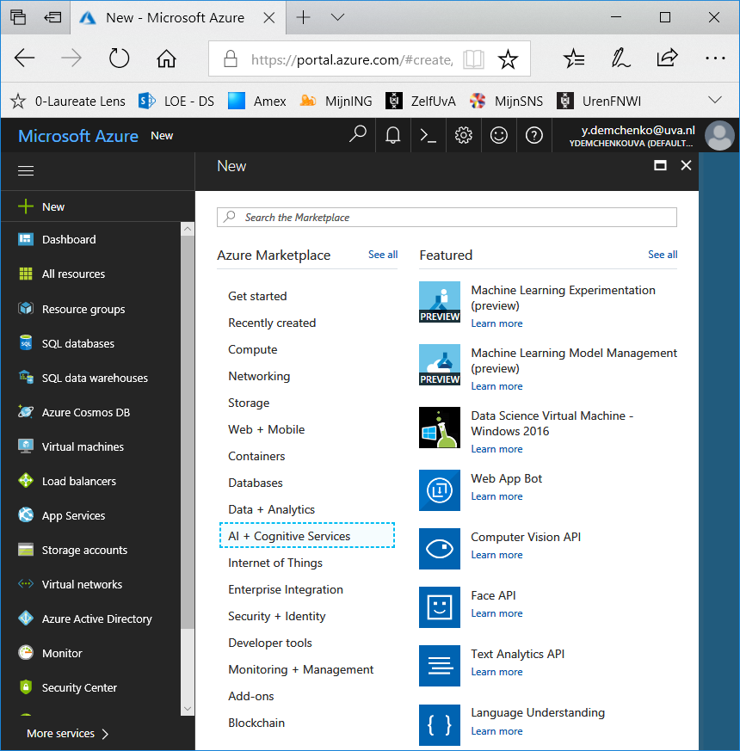
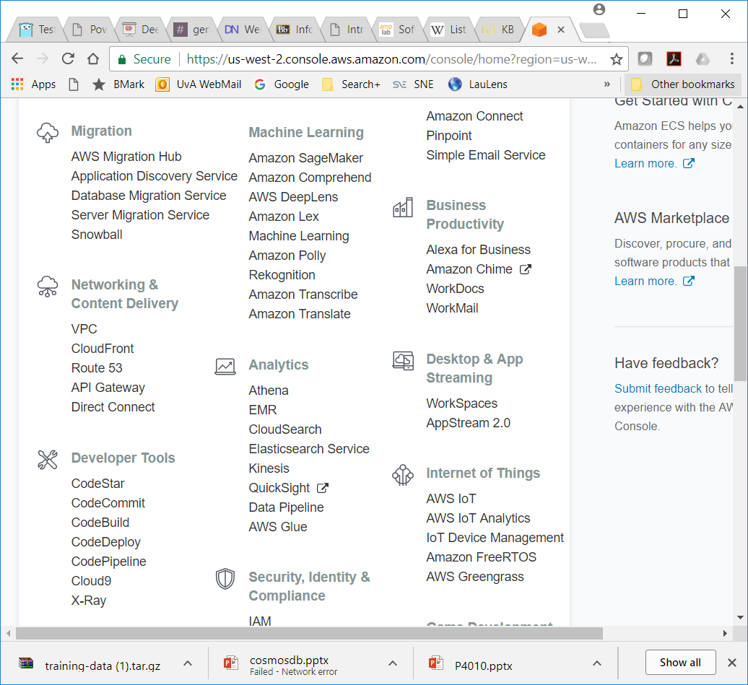
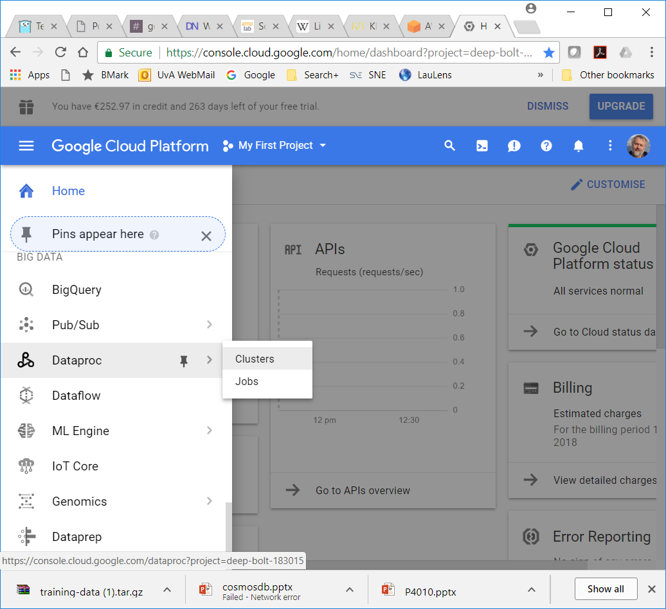
Google, AWS, Azure Big Data Stacks

Slide 29
AWS Cloud Big Data Services
AWS Cloud offers the following services and resources for Big Data processing:
EC2 Virtual Machine (VM) instances for HPC optimized for computing (with multiple cores) and with extended storage for large data processing.
Amazon Elastic MapReduce (EMR) provides the Hadoop framework on Amazon EC2 and offers a wide range of Hadoop related tools.
Amazon Kinesis is a managed service for real-time processing of streaming big data (throughput scaling from megabytes to gigabytes of data per second and from hundreds of thousands different sources).
Amazon DynamoDB highly scalable NoSQL data stores with sub-millisecond response latency.
Amazon Aurora scalable SQL/relational database.
Amazon Redshift fully-managed petabyte-scale Data Warehouse in cloud at cost less than $1000 per terabyte per year.
Amazon Machine Learning
Machine Learning (Artificial Intelligence) based services (Lex, Translate, Recognition, etc.)

Slide 30
Google Cloud Platform (GCP)
Compute
AppEngine
Google Functions (serverless with Node.js)
Storage: Static, sharing, backup, for applications and computation
Cloud Spanner SQL database
Big Data
BigQuery – Hadoop Data Warehouse
Machine Learning services
Translate
Prediction
Cloud endpoints

Slide 31
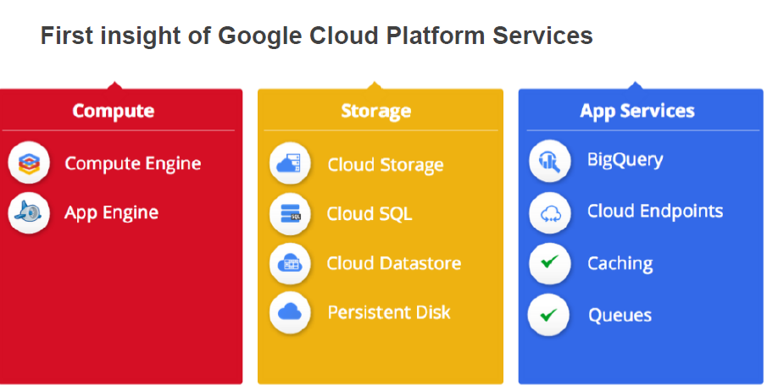
Google Cloud Platform (GCP) structure

Slide 32
Google Machine Learning
Support all stages of ML workflow
Key models exposed via APIs (Democratizing Machine Learning)
Multiple Tensorflow ML models in use (portable)
Dataprep: Serverless platform for all stages of the analytics data lifecycle

Slide 33
Microsoft Azure Big Data Services
New Big Data data-centric thinking
Azure Data Lakes
HDInsight

Slide 34
Traditional business analytics process
Start with end-user requirements to identify desired reports and analysis
Define corresponding database schema and queries
Identify the required data sources
Create a Extract-Transform-Load (ETL) pipeline to extract required data (curation) and transform it to target schema (‘schema-on-write’)
Create reports, analyze data
New
requirements
Create ETL pipeline
Identify data sources
Create reports Do analytics
Identify data schema and queries
Relational
Dedicated ETL tools (e.g. SSIS)
ETL pipeline
Queries
LOB Applications
Defined schema
Results
All data not immediately required is discarded or archived

Slide 35
New Big Data thinking: All data has value
All data has potential value
Data hoarding (data acquisition and reluctantly deleting)
No defined schema—stored in native format
Schema is imposed and transformations are done at query time (schema-on-read).
Apps and users interpret the data as they see fit
Iterate
Gather data from all sources
Store indefinitely
Analyze
See results

Slide 36
Two approaches to information management for analytics: Top-down and bottom-up
Top-down
(deductive)
Bottom-up
(inductive)
How can we make it happen?
Prescriptive analytics
What will happen?
Theory
Theory
Predictive analytics
Why did it happen?
Hypothesis
Hypothesis
OPTIMIZATION
Pattern
What happened?
Diagnostic analytics
Observation
Observation
Confirmation
Descriptive analytics
VALUE
INFORMATION
DIFFICULTY
Data Warehousing uses a top-down approach
The Data Lake uses a bottom-up approach
Ingest all data – Store all data – Do analysis (on purpose)

Slide 37
Data Lakes - Definition
Data Lake allows an organization to store all of their data, structured and unstructured, in one, centralized repository.
Since data can be stored as-is, there is no need to convert it to a predefined schema and you no longer need to know what questions you want to ask of your data beforehand.
A Data Lake should support the following capabilities:
Collecting and storing any type of data, at any scale and at low costs
Securing and protecting all of data stored in the central repository
Searching and finding the relevant data in the central repository
Quickly and easily performing new types of data analysis on datasets
Querying the data by defining the data’s structure at the time of use (schema on read)

Slide 38
Data Lake layers
Raw data layer – Raw events are stored for historical reference. Also called staging layer or landing area
Cleansed data layer – Raw events are transformed (cleaned and mastered) into directly consumable data sets. Aim is to uniform the way files are stored in terms of encoding, format, data types and content (i.e. strings). Also called conformed layer
Application data layer – Business logic is applied to the cleansed data to produce data ready to be consumed by applications (i.e. DW application, advanced analysis process, etc). Also called workspace layer or trusted layer
Still need data governance so your data lake does not turn into a data swamp!

Slide 39







Azure Data Lake in Azure Big Data Stack
Information management
Big data stores
Machine Learning and Analytics
Dashboards and visualizations
Business apps
Power BI
Azure
Data Factory
Azure
SQL Data Warehouse
Azure
Machine Learning
Personal digital assistant
Cortana
People
Azure
Stream Analytics
Custom apps
Azure
Data Catalog
Perceptual intelligence
Azure
HDInsight (Hadoop)
Face, vision
Azure
Data Lake Store
Speech, text
Azure
Event Hub
Azure
Data Lake Analytics
Business scenarios
Sensors and devices
Recommendations,
customer churn,
forecasting
Automated systems
DATA
INTELLIGENCE
ACTION
Azure Data Lake Store (ADLS)
Azure Data Lake Analytics (ADLA)
Part of Cortana Analytics Suite

Slide 40




What is Azure Data Lake (ADL) Store?
A highly scalable, distributed, parallel file system in the cloud specifically designed to work with multiple analytic frameworks
Devices
Video
ADL Analytics
Clickstream
Web
HDInsight
ADL Store
R
Social
Sensors
Spark
Relational
LOB applications
Machine Learning
Unstructured
Semi-structured
Structured
Unlimited account size TB, PB
Individual files size from gigabytes to petabytes
No limits to scale

Slide 41







Azure HDInsight – What is it?
A standard Apache Hadoop distribution offered as a managed service on Microsoft Azure
Based on Hortonworks Data Platform (HDP)
Provisioned as clusters on Azure that can run on Windows or Linux servers
Offers capacity-on-demand, pay-as-you-go pricing model
Integrates with:
Azure Blob Storage and Azure Data Lake Store for Hadoop File System (HDFS)
Azure Portal for management and administration
Visual Studio for application development tooling
Hive
In addition to the core, HDInsight supports the Hadoop ecosystem

Slide 42
HDInsight and Hadoop ecosystem (2017)
Pipeline/ workflow
(Oozie)
JavaScript
C#, F#, .NET
Graph
(Pegasus)
Stats processing
(RHadoop)
Machine Learning
(Mahout)
Data integration
(ODBC/SQOOP/REST)
Relational
(SQL Server)
Legend
Red =
Core Hadoop
Blue = Data processing
Gray = Microsoft integration points and value adds
Orange =
Data movement
Green = Packages
Metadata
(HCatalog)
PDW PolyBase
Real-time processing (Storm)
NoSQL Database
(HBase)
Scripting
(Pig)
Query
(Hive)
Event-driven processing
Distributed processing
(MapReduce)
Event pipeline
(Event hub/ flume)
Business Intelligence
(Excel, Power BI, SSAS)
YARN
Distributed storage (HDFS)
Monitoring & deployment (System Center)
World's data (Azure Data Marketplace)
Azure Storage Vault (ASV)
Active Directory (Security)
HDInsight supports Mahout, HBase, Storm, Hive, Spark

Slide 43
DevOps and DataOps

Slide 44
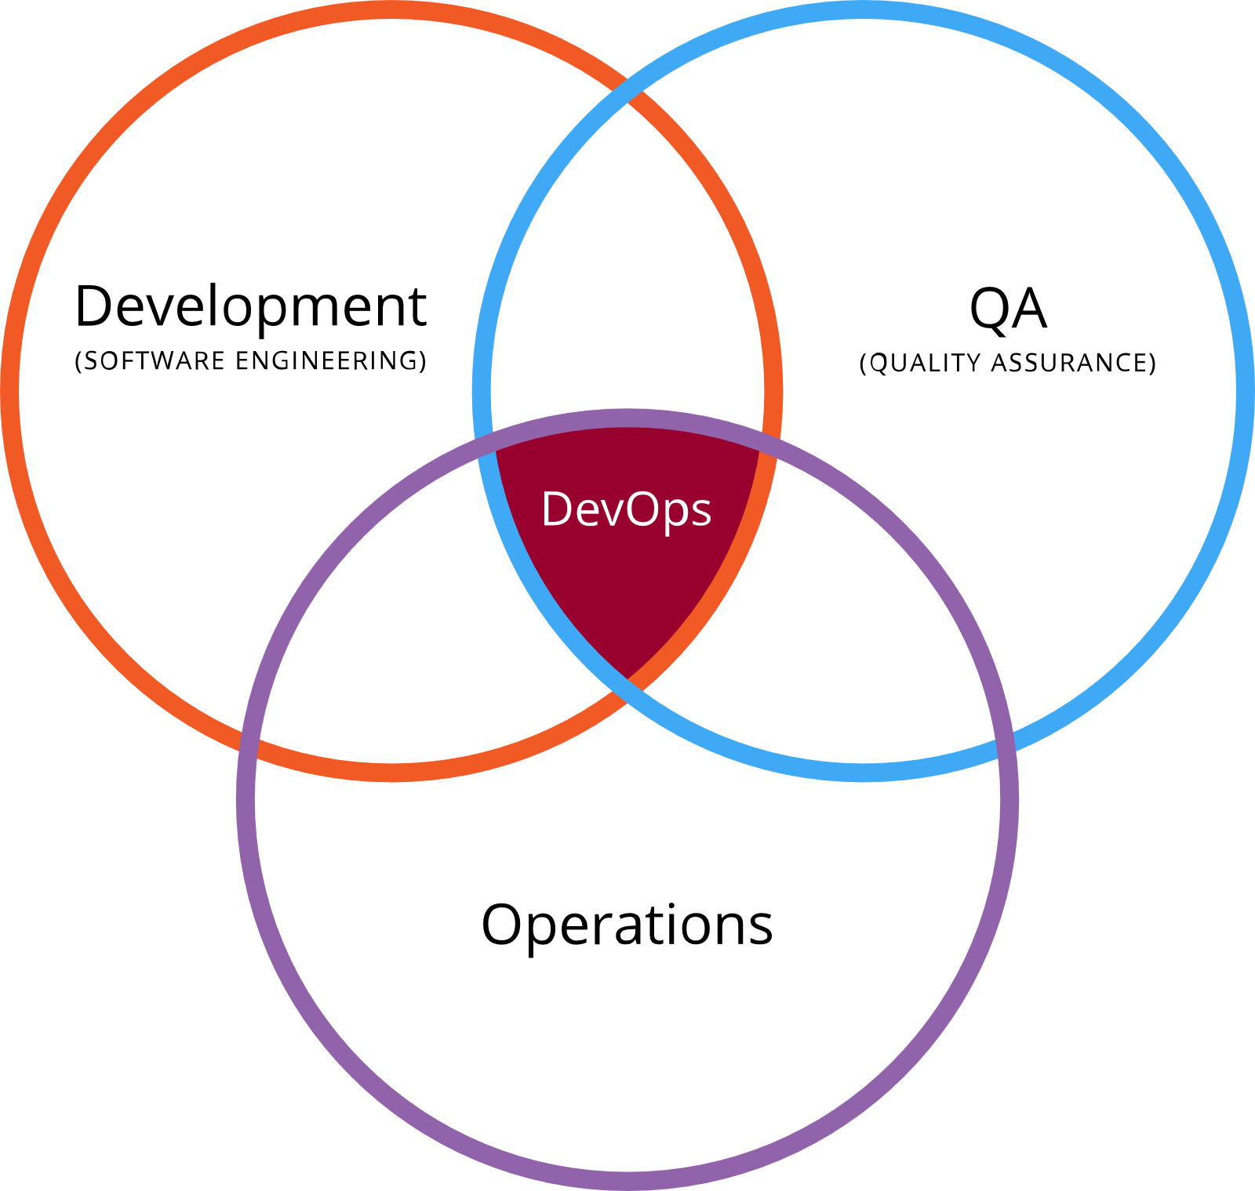
DevOps
DevOps is the practice of operations and development engineers participating together in the entire service lifecycle, from design through the development process to production support.
DevOps Essentials
Better Software, Faster time to market
Movement Comes from Open Source
Synergy of Development and Operations
Covers the *entire* Application LifeCycle

Slide 45
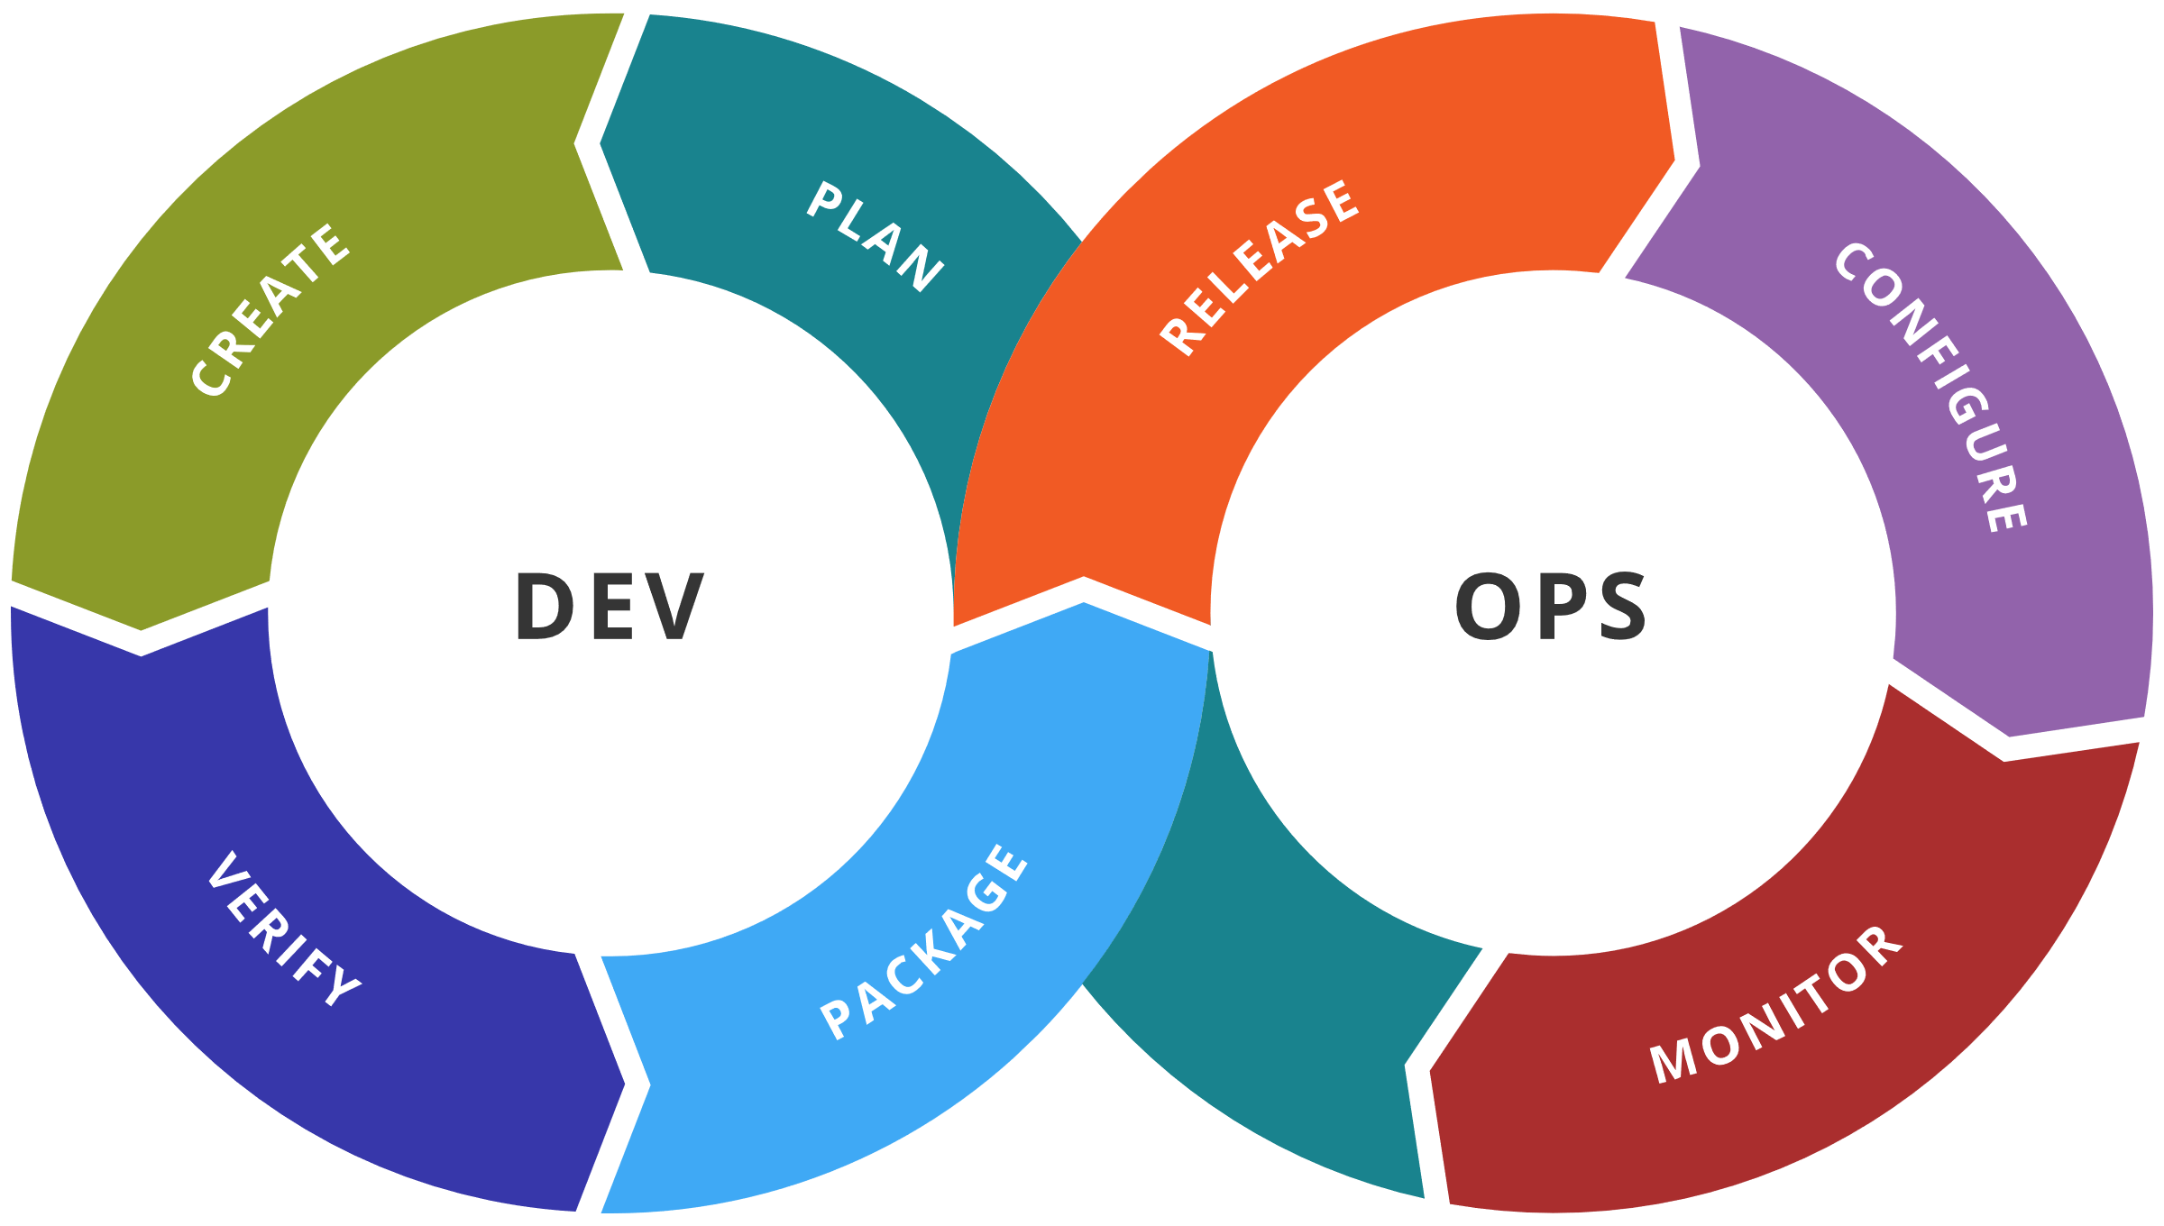
DevOps Toolchain
DevOps is a cultural shift and collaboration between development, operations and testing, enabled by DevOps toolchain
Code — Code development and review, version control tools, code merging
Build — Continuous integration tools, build status
Test — Test and results determine performance
Package — Artifact repository, application pre-deployment staging
Release — Change management, release approvals, release automation
Configure — Infrastructure configuration and management, Infrastructure as Code tools
Monitor — Applications performance monitoring, end–user experience

Slide 46


Cloud-powered Services Development Lifecycle
Configuration Management & Orchestration
Dev
Test/QA
Staging
Prod
2-tier app
with test DB
2-tier app with
production data
All in one instance
2-tier app with
production data
Multi-AZ and HA
Amazon CloudFormation + Chef (or Puppet)
Easily creates test environment close to real
Powered by cloud deployment automation tools
To enable configuration Management and Orchestration, Deployment automation
Continuous development – test – integration
CloudFormation Template, Configuration Template, Bootstrap Template
Can be used with Puppet and Chef, two configuration and deployment management systems for clouds
[ref] Building Powerful Web Applications in the AWS Cloud” by Louis Columbus http://softwarestrategiesblog.com/2011/03/10/building-powerful-web-applications-in-the-aws-cloud/
Notes:
The Cloud-powered Software Development Lifecycle is one of Continuous integration, as the slide illustrates
Allows testing close to the real environment
CloudFormation helps in automating deployment, modification, and making snapshot of working configuration/stack

Slide 47
Azure DevOps Services (since 10 Sept 2018, former VSTS)
Azure DevOps Services is a cloud service for collaborating on code development.
Azure Pipelines
CI/CD that works with any language, platform, and cloud.
Azure Repos
Unlimited cloud-hosted private Git and TFVC repos for your project.
Azure Boards
Work tracking with Kanban boards, backlogs, team dashboards, and custom reporting.
Azure Test Plans
All-in-one planned and exploratory testing solution.
Azure Artifacts
Maven, npm, and NuGet package feeds from public and private sources.
Built-in wiki for sharing information with DevOps team

Slide 48
Azure DevOps Processes
Continuous integration (CI)
Take advantage of continuous integration to improve software development quality and speed. When you use Azure DevOps or Jenkins to build apps in the cloud and deploy to Azure, each time you commit code, it’s automatically built and tested—so bugs are detected faster.
Continuous delivery (CD)
Ensure that code and infrastructure are always in a production-deployable state, with continuous delivery. By combining continuous integration and infrastructure as code (IaC), you’ll achieve identical deployments and the confidence you need to manually deploy to production at any time.
Continuous deployment with CI/CD
With continuous deployment, you can automate the entire process from code commit to production if your CI/CD tests are successful. Using CI/CD practices, paired with monitoring tools, you’ll be able to safely deliver features to your customers as soon as they’re ready.

Slide 49
DataOps
DataOps (data operations) is an emerging discipline that brings together DevOps teams with data engineer and data scientist roles to provide the tools, processes and organizational structures to support the data-focused enterprise.
DataOps is a new approach to the end-to-end data lifecycle, which applies new processes and methodologies to data analytics.
Agile software development helps deliver new analytics faster and with higher quality.
DevOps automates the deployment of new analytics and data.
Statistical process controls, used in lean manufacturing, test and monitor the quality of data flowing through the data-analytics pipeline.

Slide 50
Data Exchange and Data Markets

Slide 51
Data Exchange and Data Markets
IoT is considered as a key use case and a facilitator for Data Markets
Potentially many consumers for centrally or locally operated IoT infrastructure
IoT networks create valuable data that can be used for multiple purpose
IoT data can be exchanged and traded
Open and Public data
Current trading models are simple and in most cases are free or by subscription
Making data economical goods would require new operational models, infrastructure and tools

Slide 52
Modern data architecture vs Data Market
Characteristics of modern data architecture
Customer-centric
Automated
Smart
Adaptable, Agile
Cloud based, Elastic
Collaborative
Governed
Secure, Trusted
Characteristics of emerging data markets
Customer-centric
Automated
Smart
Regional/sectoral specialised
Cloud powered/integrated
Collaborative
Governed
Secure, Trusted
Auditable
Transparent
Commoditised/Monetised
Combining data and algorithms (as part of containers)

Slide 53
Data Properties as Economic Goods
STREAM data principles for industrial and commoditised data
[S] Sovereign
[T] Trusted
[R] Reusable
[E] Exchangeable
[A] Actionable
[M] Measurable
Other data properties: Important to commoditise data
Quality, Valuable, Auditable/Trackable, Brandable, Authentic
Interoperable, Findable, Accessible, not-Rival, Composable
Ownership and IPR
Leverages FAIR principles for research data
Findable – Accessible – Interoperable - Reusable

Slide 54
Data Market Architecture components
Data Source (producer/seller/publisher) – Supply side
Data Target (consumer, buyer, subscriber) – Demand side
Data Broker
Data/Value Broker
Trust Broker or Trusted Introducer
Directory or Catalog service
Including data (quality) ranking
Including API link or repository
Data Exchange
Infrastructure component vs peer-to-peer customer network
Provenance and transactions control issue
Data Storage/Cache Data Delivery Network
Data Lake (HDFS based and SQL/NoSQL)
Caching for traffic optimisation in DDN
Open/Public Data access and storage
Can be stored to offer as part of DM storage
Facilitate quality of data analytics
Data Transfer vs Data Access
Scenario: App container vs Data container
Container security using Intel TXT or SGX technology
(Optional) Secure data processing
Used for data quality inspection (e.g. P.I.D., or IP), auditing, composition
Data preparation/conditioning
Re-using experience of Internet eXchange, Cloud eXchange and Financial Exchanges

Slide 55
International Data Space Association
Started 2016 as Industrial Data Space initiative (supported by German project)
Re-defined as International Data Space Association (IDSA)
Published International Data Space Architecture Version 2.0 (2018)
Whitepaper and use cases
Associated H2020 projects
Boost4.0 – Big Data for Factories (20 Mln (100 Mln private), 3yrs, 50 partners, 16 countries)
MIDIH – Manufacturing Industry Digital Innovation Hub (22 partners, 12 countries)
Services: technological, business, skills building
Open calls
Close cooperation with FIWARE Foundation (cloud like infrastructure resulted from Future Internet program)
Positions itself against IoT and Open-Data solutions in the areas of smart cities, Industry 4.0 and agriculture
Ongoing active outreach developments
Data Sovereignty and Secure Data Exchange model
Data Markets
Trusted platforms

Slide 56
General Structure of IDS Architecture
Specification defines functionalities by layers
Details are sufficient to define processes, functional components and API

Slide 57
Cloud based IDS infrastructure for Data Exchange and Trading
IDS Connector is the main functional component
No specifically defined common infrastructure services

Slide 58
Competences, Skills and Learning

Slide 59

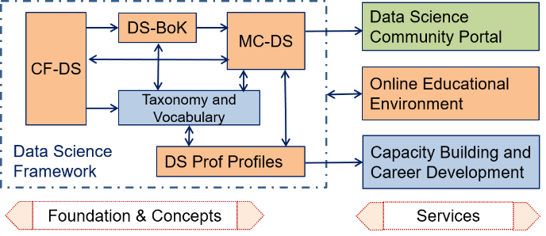
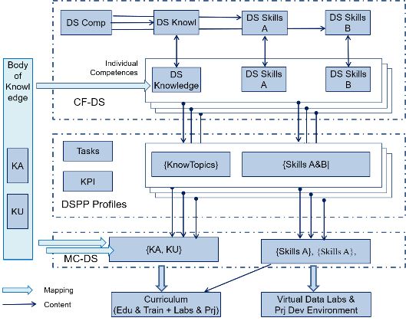
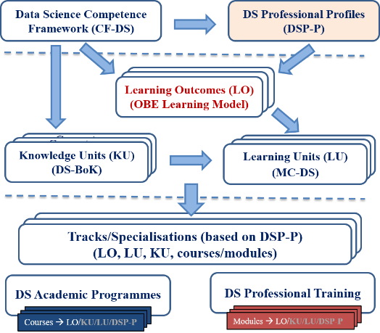
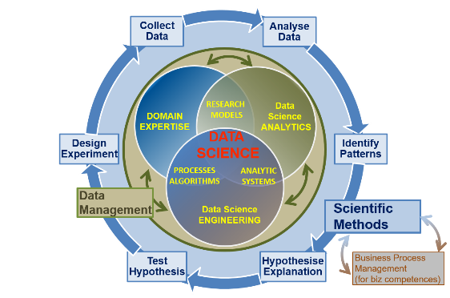
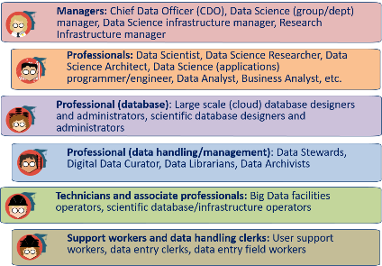
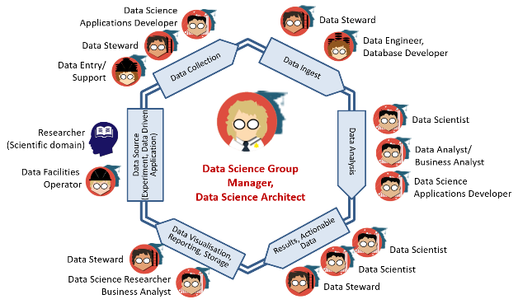
EDISON Products for Data Science Skills Management and Curriculum Design
EDISON Data Science Framework (EDSF)
Compliant with EU standards on competences and professional occupations e-CFv3.0, ESCO
Customisable courses design for targeted education and training
Skills development and career management for Core Data Experts and related data handling professions
Capacity building and Data Science team design
Academic programmes and professional training courses (self) assessment and design
Cooperation with International professional organisations IEEE, ACM, BHEF, APEC (AP Economic Cooperation )

Slide 60
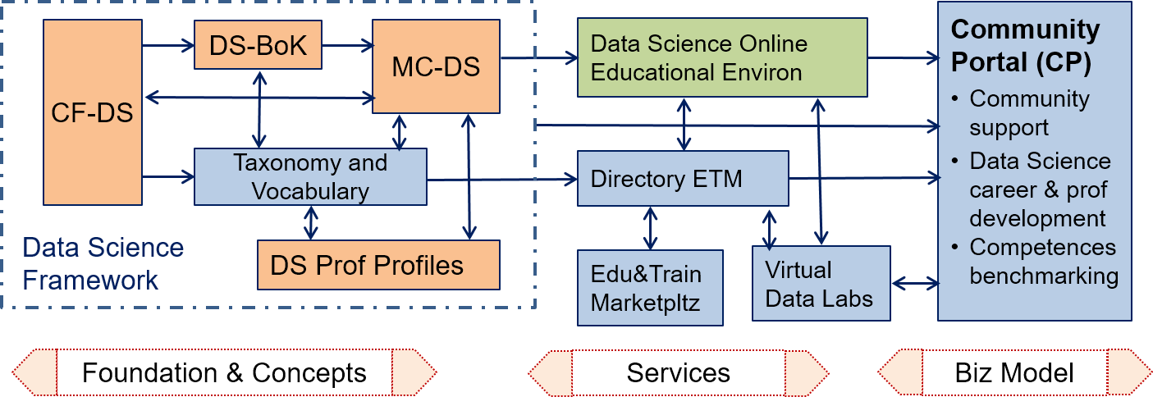
EDISON Data Science Framework (EDSF)
EDISON Framework components
CF-DS – Data Science Competence Framework
DS-BoK – Data Science Body of Knowledge
MC-DS – Data Science Model Curriculum
DSP – Data Science Professional profiles
Data Science Taxonomies and Scientific Disciplines Classification
EOEE - EDISON Online Education Environment
Methodology
ESDF development based on job market study, existing practices in academic, research and industry.
Review and feedback from the ELG, expert community, domain experts.
Input from the champion universities and community of practice.

Slide 61

Data Scientist definition
Based on the definitions by NIST SP1500 – 2015, extended by EDISON
A Data Scientist is a practitioner who has sufficient knowledge in the overlapping regimes of expertise in business needs, domain knowledge, analytical skills, and programming and systems engineering expertise to manage the end-to-end scientific method process through each stage in the big data lifecycle till the delivery of an expected scientific and business value to organisation or project.
Core Data Science competences and skills groups
Data Science Analytics (including Statistical Analysis, Machine Learning, Business Analytics)
Data Science Engineering (including Software and Applications Engineering, Data Warehousing, Big Data Infrastructure and Tools)
Domain Knowledge and Expertise (Subject/Scientific domain related)
EDISON identified 2 additional competence groups demanded by organisations
Data Management, Data Governance, Stewardship, Curation, Preservation
Research Methods and/vs Business Processes/Operations
Data Science professional skills: Thinking and acting like Data Scientist – required to successfully develop as a Data Scientist and work in Data Science teams

Slide 62

Data Science Competence Groups - Research
Data Science Competences include 5 groups
Data Science Analytics
Data Science Engineering
Domain Knowledge and Expertise
Data Management
Research Methods and Project Management
Business Process Management (biz)
Scientific Methods
Design Experiment
Collect Data
Analyse Data
Identify Patterns
Hypothesis Explanation
Test Hypothesis
Business Operations
Operations Strategy
Plan
Design & Deploy
Monitor & Control
Improve & Re-design

Slide 63
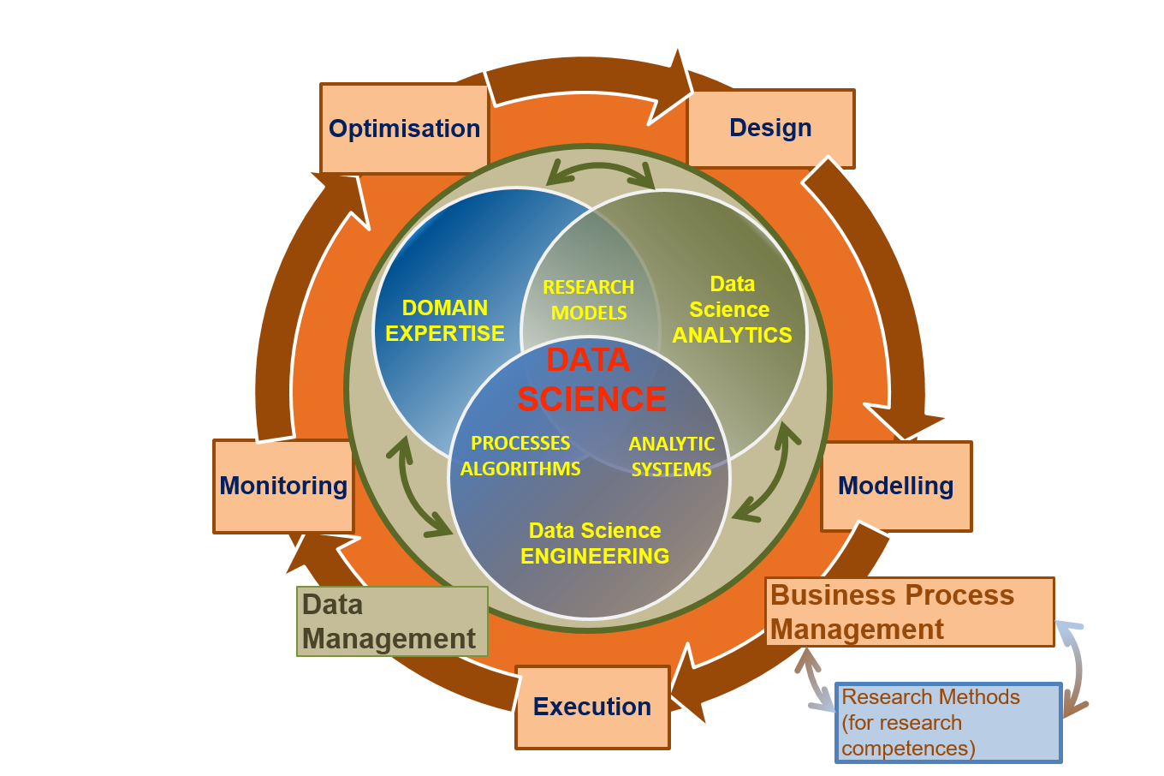
Data Science Competences Groups – Business
Data Science Competences include 5 groups
Data Science Analytics
Data Science Engineering
Domain Knowledge and Expertise
Data Management
Research Methods and Project Management
Business Process Management (biz)
Scientific Methods
Design Experiment
Collect Data
Analyse Data
Identify Patterns
Hypothesise Explanation
Test Hypothesis
Business Process Operations/Stages
Design
Model/Plan
Deploy & Execute
Monitor & Control
Optimise & Re-design

Slide 64
Identified Data Science Competence Groups
 | Data Science Analytics (DSDA) | Data Science Engineering (DSENG) | Data Management and Governance (DSDM) | Research/Scientific Methods and Project Management (DSRMP) | Data Science Domain Knowledge, e.g. Business Analytics (DSDK/DSBPM)
0 | Use appropriate data analytics and statistical techniques on available data to deliver insights into research problem or org. processes and support decision making | Use engineering principles and modern computer technology to research, design, implement new data analytics applications, develop experiments, processes, instruments, systems and infrastructures to support data handling during the whole data lifecycle | Develop and implement data management strategy for data collection, storage, preservation, and availability for further processing. | Create new understandings and capabilities by using the scientific method (hypothesis, test/artefact, evaluation) or similar engineering methods to discover new approaches to create new knowledge and achieve research or organisational goals | DSDK/DSBA Use domain knowledge (scientific or business) to develop relevant data analytics applications; adopt general Data Science methods to domain specific data types and presentations, data and process models, organisational roles and relations
1 | DSDA01 Effectively use variety of data analytics techniques | DSENG01 Use engineering principles (general and software) to research, design, develop and implement new instruments and applications | DSDM01 Develop and implement data strategy, in particular, Data Management Plan (DMP) | DSRMP01 Create new understandings and capabilities by using scientific/ research methods | DSBPM01 Understand business and provide insight, translate unstructured business problems into an abstract mathematical framework
2 | DSDA02 Apply designated quantitative techniques | DSENG02 Develop and apply computer methods to domain related problems | DSDM02 Develop data models including metadata | DSRMP02 Direct systematic study toward a fuller knowledge or understanding of the observable facts | DSBPM02 Participate strategically and tactically in financial decisions
3 | DSDA03 Pull together data from diff sources … | DSENG03 Develop and prototype data analytics applications | DSDM03 Collect integrate data | DSRMP03 Undertakes creative work | DSBPM03 Provides support services to other
4 | DSDA04 Use diff perform techniques | DSENG04 Develop, deploy operate Big Data storage | DSDM04 Maintain repository | DSRMP04 Translate strategies into actions | DSBPM04 Analyse data for marketing
5 | DSDA05 Develop analytics applic | DSENG05 Apply security mechanisms | DSDM05 Visualise cmplx data | DSRMP05 Contribute to organis goals | DSBPM05 Analyse optimise customer relatio
6 | DSDA06 Visualise results of analysis, dashboards | DSENG06 Design, build, operate SQL and NoSQL | DSRM06 Develop and manage prolicies | DSRMP06 Develop and guide data driven projects | DSBPM06 Analyse data for marketing

Slide 65
Identified Data Science Skills/Experience Groups
Skills Type A – Based on knowledge acquired
Group 1: Skills/experience related to competences
Data Analytics and Machine Learning
Data Management/Curation (including both general data management and scientific data management)
Data Science Engineering (hardware and software) skills
Scientific/Research Methods or Business Process Management
Application/subject domain related (research or business)
Group 2: Mathematics and statistics
Mathematics and Statistics and others
Skills Type B – Base on practical or workplace experience
Group 3: Big Data (Data Science) tools and platforms
Big Data Analytics platforms
Mathematics & Statistics applications & tools
Databases (SQL and NoSQL)
Data Management and Curation platform
Data and applications visualisation
Cloud based platforms and tools
Group 4: Data analytics programming languages and IDE
General and specialized development platforms for data analysis and statistics
Group 5: Soft skills and Workplace skills
Data Science professional skills: Thinking and Acting like Data Scientist
21st Century Skills: Personal, inter-personal communication, team work, professional network

Slide 66
Data Science Professional Skills: Thinking and Acting like Data Scientist
Recognise value of data, work with raw data, exercise good data intuition, use SN and open data
Accept (be ready for) iterative development, know when to stop, comfortable with failure, accept the symmetry of outcome (both positive and negative results are valuable)
Good sense of metrics, understand importance of the results validation, never stop looking at individual examples
Ask the right questions
Respect domain/subject matter knowledge in the area of data science
Data driven problem solver and impact-driven mindset
Be aware about power and limitations of the main machine learning and data analytics algorithms and tools
Understand that most of data analytics algorithms are statistics and probability based, so any answer or solution has some degree of probability and represent an optimal solution for a number variables and factors
Recognise what things are important and what things are not important (in data modeling)
Working in agile environment and coordinate with other roles and team members
Work in multi-disciplinary team, ability to communicate with the domain and subject matter experts
Embrace online learning, continuously improve your knowledge, use professional networks and communities
Story Telling: Deliver actionable result of your analysis
Attitude: Creativity, curiosity (willingness to challenge status quo), commitment in finding new knowledge and progress to completion
Ethics and responsible use of data and insight delivered, awareness of dependability (data scientist is a feedback loop in data driven companies)

Slide 67
21st Century Skills (DARE & BHEF & EDISON)
Critical Thinking: Demonstrating the ability to apply critical thinking skills to solve problems and make effective decisions
Communication: Understanding and communicating ideas
Collaboration: Working with other, appreciation of multicultural difference
Creativity and Attitude: Deliver high quality work and focus on final result, intitiative, intellectual risk
Planning & Organizing: Planning and prioritizing work to manage time effectively and accomplish assigned tasks
Business Fundamentals: Having fundamental knowledge of the organization and the industry
Customer Focus: Actively look for ways to identify market demands and meet customer or client needs
Working with Tools & Technology: Selecting, using, and maintaining tools and technology to facilitate work activity
Dynamic (self-) re-skilling: Continuously monitor individual knowledge and skills as shared responsibility between employer and employee, ability to adopt to changes
Professional networking: Involvement and contribution to professional network activities
Ethics: Adhere to high ethical and professional norms, responsible use of power data driven technologies, avoid and disregard un-ethical use of technologies and biased data collection and presentation

Slide 68
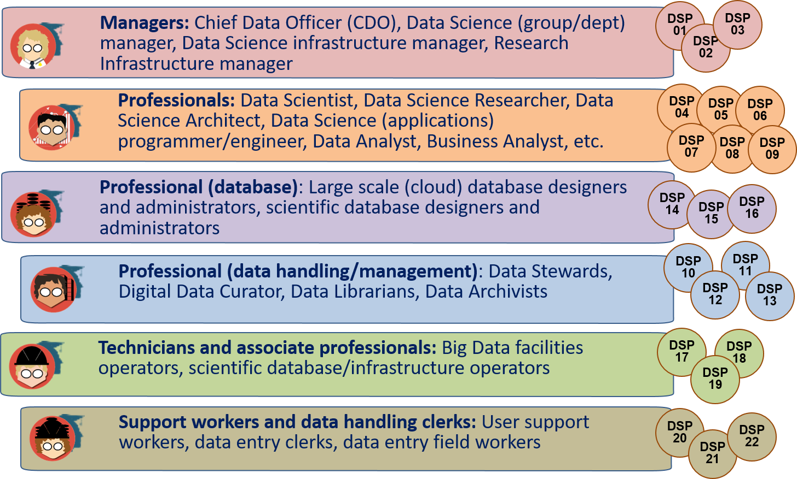
Data Science Professions Family
Icons used: Credit to [ref] https://www.datacamp.com/community/tutorials/data-science-industry-infographic

Slide 69

Data Science Body of Knowledge (DS-BoK) What Data Scientists (different profiles) need to know
DS-BoK Knowledge Area Groups (KAG)
KAG1-DSA: Data Analytics group including Machine Learning, statistical methods, and Business Analytics
KAG2-DSE: Data Science Engineering group including Software and infrastructure engineering
KAG3-DSDM: Data Management group including data curation, preservation and data infrastructure
KAG4-DSRM: Research Methods and Project Management group
KAG5-DSBA: Business Analytics and Business Intelligence
KAG* - DSDK: Data Science domain knowledge to be defined by related expert groups

Slide 70
Data Science Body of Knowledge (1)
KA Groups | Suggested DS Knowledge Areas (KA) | Knowledge Areas from existing BoK and CCS2012 scientific subject groups
KAG1-DSDA: Data Science Analytics | KA01.01 (DSDA.01/SMDA) Statistical methods for data analysis KA01.02 (DSDA.02/ML) Machine Learning KA01.03 (DSDA.03/DM) Data Mining KA01.04 (DSDA.04/TDM) Text Data Mining KA01.05 (DSDA.05/PA) Predictive Analytics KA01.06 (DSDA.06/MODSIM) Computational modelling, simulation and optimisation | There is no formal BoK defined for Data Analytics. Data Science Analytics related scientific subjects from CCS2012: CCS2012: Computing methodologies CCS2012: Mathematics of computing CCS2012: Computing methodologies
KAG2-DSENG: Data Science Engineering | KA02.01 (DSENG.01/BDI) Big Data Infrastructure and Technologies KA02.02 (DSENG.02/DSIAPP) Infrastructure and platforms for Data Science applications KA02.03 (DSENG.03/CCT) Cloud Computing technologies for Big Data and Data Analytics KA02.04 (DSENG.04/SEC) Data and Applications security KA02.05 (DSENG.05/BDSE) Big Data systems organisation and engineering KA02.06 (DSENG.06/DSAPPD) Data Science (Big Data) applications design KA02.07 (DSENG.07/IS) Information systems (to support data driven decision making) | ACM CS-BoK selected KAs: AR - Architecture and Organization (including computer architectures and network architectures) CN - Computational Science IM - Information Management SE - Software Engineering (can be extended with specific SWEBOK KAs) SWEBOK selected KAs Software requirements Software design Software engineering process Software engineering models and methods Software quality Data Science Analytics related scientific subjects from CCS2012

Slide 71
Data Science Body of Knowledge (2)
KA Groups | Suggested DS Knowledge Areas (KA) | Knowledge Areas from existing BoK and CCS2012 scientific subject groups
KAG3-DSDM: Data Management | KA03.01 (DSDM.01/DMORG) General principles and concepts in Data Management and organisation KA03.02 (DSDM.02/DMS) Data management systems KA03.03 (DSDM.03/EDMI) Data Management and Enterprise data infrastructure KA03.04 (DSDM.04/DGOV) Data Governance KA03.05 (DSDM.05/BDST0R) Big Data storage (large scale) KA03.06 (DSDM.05/DLIB) Digital libraries and archives | DM-BoK selected KAs (1) Data Governance, (2) Data Architecture, (3) Data Modelling and Design, (4) Data Storage and Operations, (5) Data Security, (6) Data Integration and Interoperability, (7) Documents and Content, (8) Reference and Master Data, (9) Data Warehousing and Business Intelligence, (10) Metadata, and (11) Data Quality.
KAG4-DSRM: Research Methods and Project Management | KA04.01 (DSRMP.01/RM) Research Methods KA04.01 (DSRMP.02/PM) Project Management | There are no formally defined BoK for research methods PMI-BoK selected KAs Project Integration Management Project Scope Management Project Quality Project Risk Management
KAG5-DSBPM: Business Analytics | KA05.01 (DSBA.01/BAF) Business Analytics Foundation KA05.02 (DSBA.02/BAEM) Business Analytics organisation and enterprise management | BABOK selected KAs *) Business Analysis Planning and Monitoring Requirements Life Cycle Management Solution Evaluation and improvements recommendation

Slide 72
DSP04 Data Scientist – Required practical skills and Hands-on labs
Data Science curriculum should include the following elements to achieve necessary skills Type B:
Python (or R) and corresponding data analytics libraries
NoSQL and SQL Databases (Hbase, MongoDB, Cassandra, Redis, Accumulo, MS SQL, My SQL, PostgreSQL, etc.)
Big Data Analytics platforms (Hadoop, Spark, Data Lakes, others)
Real time and streaming analytics systems (Flume, Kafka, Storm)
Kaggle competition, resources and community platform, including rich data sets, forum and computing resources
Visualisation software (D3.js, Processing, Tableau, Julia, Raphael, etc.)
Web API management and web scrapping
Git versioning system as a general platform for software development
Development Frameworks: Python, Java or C/C++, AJAX (Asynchronous Javascript and XML), D3.js (Data-Driven Documents), jQuery, others
Cloud based Big Data and data analytics platforms and services, including large scale storage systems
Essential for workplace adjustment

Slide 73
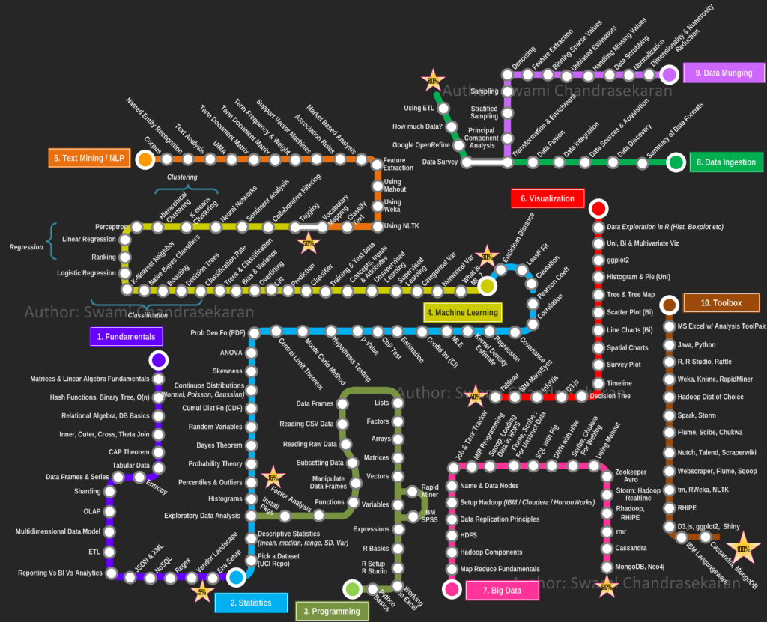
Becoming a Data Scientist by Swami Chandrasekaran (2013) http://nirvacana.com/thoughts/becoming-a-data-scientist/
Good and practical advice how to learn Data Science, step by step
Follow the route

Slide 74
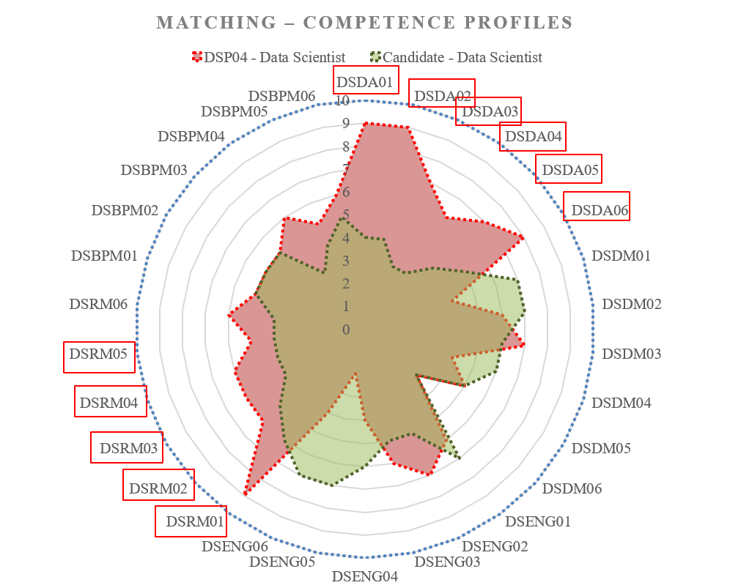
Individual Competences Benchmarking
Individual Education/Training Path based on Competence benchmarking
Red polygon indicates the chosen professional profile: Data Scientist (general)
Green polygon indicates the candidate or practitioner competences/skills profile
Insufficient competences (gaps) are highlighted in red
DSDA01 – DSDA06 Data Science Analytics
DSRM01 – DSRM05 Data Science Research Methods
Can be use for team skills match marking and organisational skills management
[ref] For DSP Profiles definition and for enumerated competences refer to EDSF documents CF-DS and DSP Profiles.

Slide 75
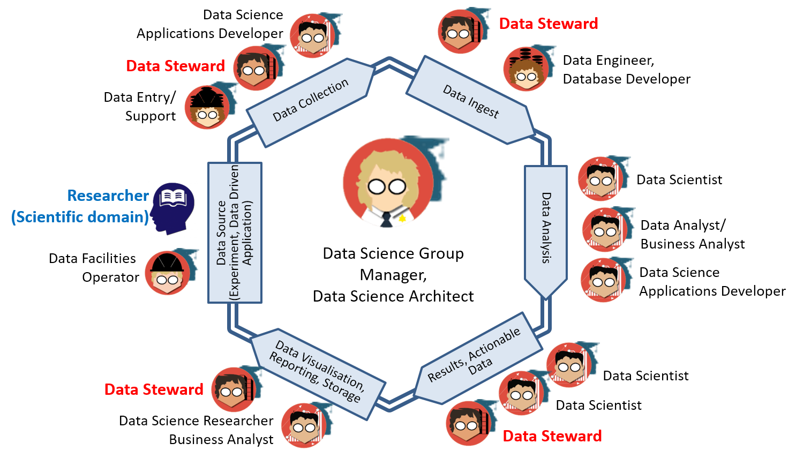
Building a Data Science Team

Slide 76
Data Science or Data Management Group/Department: Organisational structure and staffing - EXAMPLE
Data Science or Data Management Group/Department
(Managing) Data Science Architect (1)
Data Scientist (1), Data Analyst (1)
Data Science Application programmer (2)
Data Infrastructure/facilities administrator/operator: storage, cloud, computing (1)
Data stewards, curators, archivists (3-5)
Estimated: Group of 10-12 data specialists for research institution of 200-300 research staff.
Growing role and demand for Data Stewards and data stewardship
>> Reporting to CDO/CTO/CEO
Providing cross-organizational
services

Slide 77
Discussion: How to become a Data Scientist (or Big Data Architect)
Understand required Data Science and Analytics competences and skills
Build your own learning path
Assess your knowledge and start from basics
Statistics is foundation of Data (Science) Analytics
Develop statistical/probabilistic thinking
Difference between Data Science and statistics
Learn from others experience: read blogs, join forums and communities
Decide about academic degree, professional certificate, self-education/training, join local Meetup
Become involved in a real project
Remember variety of Data Scientist roles and profiles

Slide 78
Learning resources
Microsoft Virtual Academy – FREE
Google Qwik Lab - FREE
Linkedin Learning – 1 month free -> 279 USD/Year
Datacamp: Data Science with R and Python – 1 month free -> 380 USD/Year
Coursera, Udacity
Certification and training PMI, DAMA, IIBA
Pre-configured Hadoop/Spark cluster for personal use
Cloudera QuickStart for VirtualBox and Docker
Hortonworks Sanbox on VM and on container
Databricks Hadoop and Spark
Free community edition and services online
Databricks cluster available on Azure

Slide 79
Cloudera Quickstart VM for VirtualBox
Accounts
Once you launch the VM, you are automatically logged in as the cloudera user. The account details are:
username: cloudera
password: cloudera
The Cloudera account has sudo privileges in the VM. The root account password is cloudera.
The root MySQL password (and the password for other MySQL user accounts) is also cloudera.
Hue and Cloudera Manager use the same credentials.

Slide 80
Datasets
Kaggle - https://www.kaggle.com/
StackExchange data dump files https://data.stackexchange.com/stackoverflow/
Google BigQuery and public datasets - https://cloud.google.com/public-datasets/
AWS public datasets - https://aws.amazon.com/public-datasets/
Azure public datasets Azure Analytics - https://docs.microsoft.com/en-us/azure/sql-database/sql-database-public-data-sets
Azure DataMarket (retiring) http://datamarket.azure.com/browse
IBM Watson Analytics Datasets - https://www.ibm.com/communities/analytics/watson-analytics-blog/guide-to-sample-datasets/
The KB Lab hosts experimental tools and data sets based on the KB's digitised collection http://lab.kb.nl/
Many others – check Wikipedia https://en.wikipedia.org/wiki/List_of_datasets_for_machine_learning_research

Slide 81
Grants possibilities for research and education
AWS Education credits: for teachers and students (including w/o credit cards)
AWS research grants – only for pre-production services
Azure Research grants: 2-3 times a year on specified topics: ML, genomics, etc
All major CSP has trial credits
AWS – 1 Year + 200 USD
Azure – 1 month + 200 USD
Google – 1 year + 300 USD

Slide 82
Development tools – Old and new
Eclipse: Full cloud API integration
CLI cloud API integrated with the OS platform CLI
Azure Power Shell and Storage Explorer
Variety of Cloud IDE/API pluggable modules for last 3 IDE
Python tools and IDE: Jupyter/IPython Notebook, Anaconda, Spyder, Rodeo, Atom
Google Compute Engine IDE and GO language IDE
Visual Studio Code
Visual Studio Community Edition
Azure DevOps (limited free services)
Atom Hackable Editor

Slide 83
Discussion and Questions
Suggested topics for discussion
How to handle Big Data and Cloud complexity
How to become a Data Scientist, Big Data Architect, etc
This work is licensed under the Creative Commons Attribution 4.0 International License. To view a copy of this license, visit http://creativecommons.org/licenses/by/4.0/

